Slide 1
Controller’s Corner
August 24, 2016
Goals of Financial Reporting – From an Income statement to a Consolidated Cost Analysis to a Feeding Cost Analysis.

Slide 2
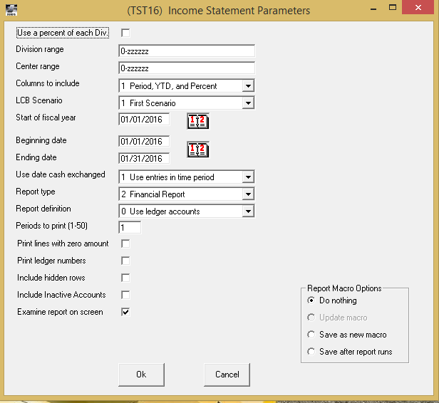
Standard Income Statement

Slide 4
Consolidated Cost Analysis Report
1) Accounting Other report
2) Not a canned report offered by FBS
3) Designed entirely by user:
a) Setup | Accounting | Consolidated Cost Analysis
b) Build from scratch
c) Build from ledger accounts
d) Columns of report are by center

Slide 5
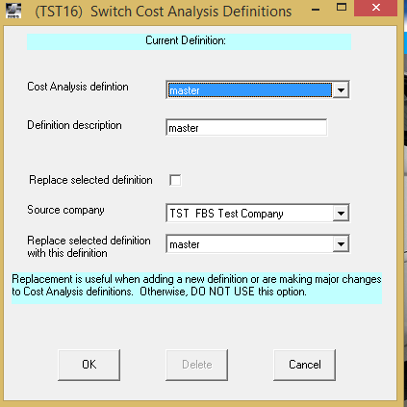
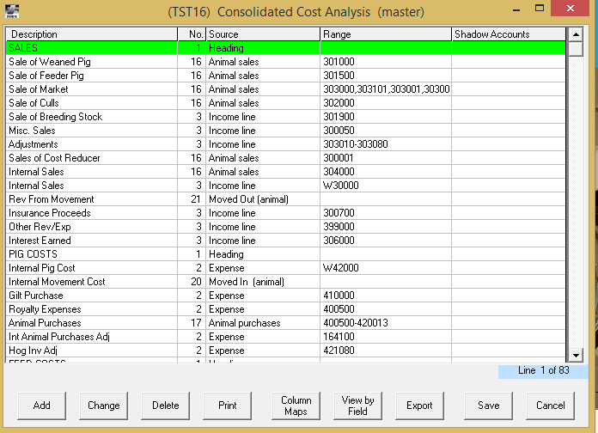
Setup of CCA report and Column Mapping
Provide a definition name Build your report format

Slide 6
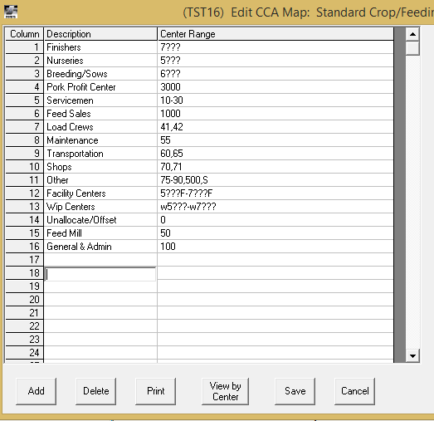
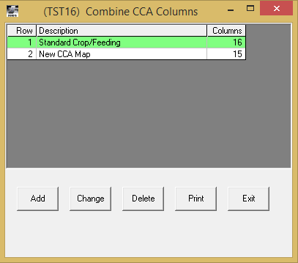
Select Column Maps
Name your column definition Define your column and what centers will roll up under each center

Slide 7
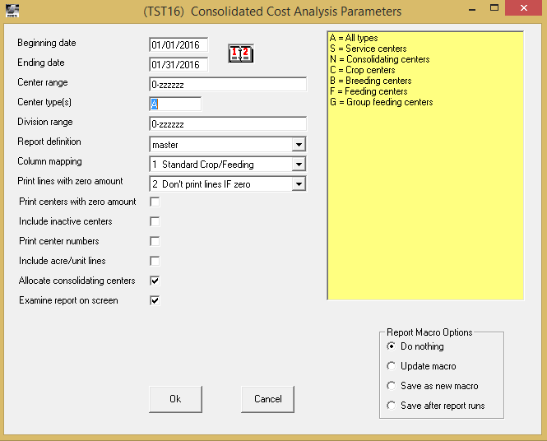

Slide 8
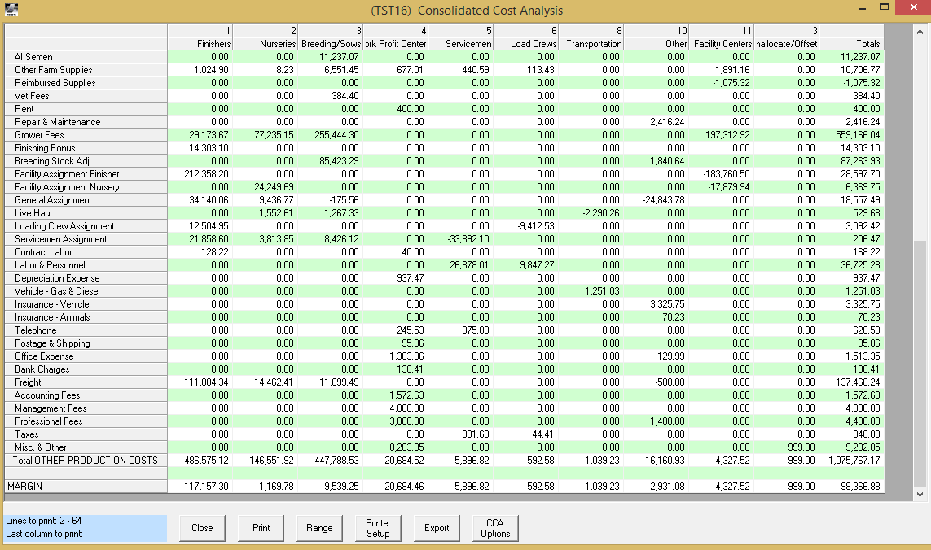
What if your CCA report does not balance to your Income Statement?

Slide 9
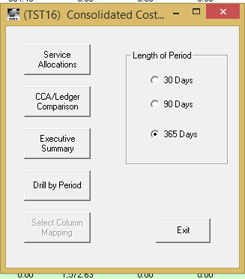
After CCA Options, Select CCA/Ledger Comparison

Slide 10
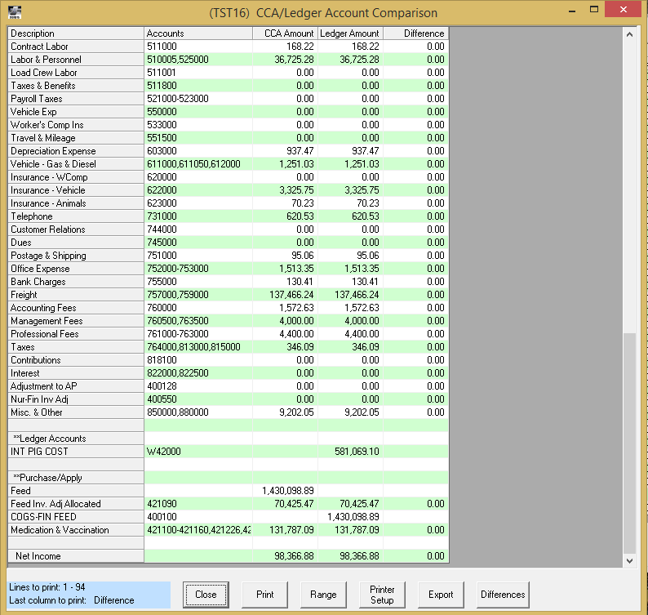
This report compares your ledger account balance to the balances in the CCA report noting a difference between the two

Slide 11
Feeding Cost Analysis Report
1) Standard Feeding report
2) Not a canned report offered by FBS
3) Designed entirely by user:
a) Setup | Feeding | Cost Analysis
b) Build from scratch
c) Build from ledger accounts
d) Columns of report are by center

Slide 12
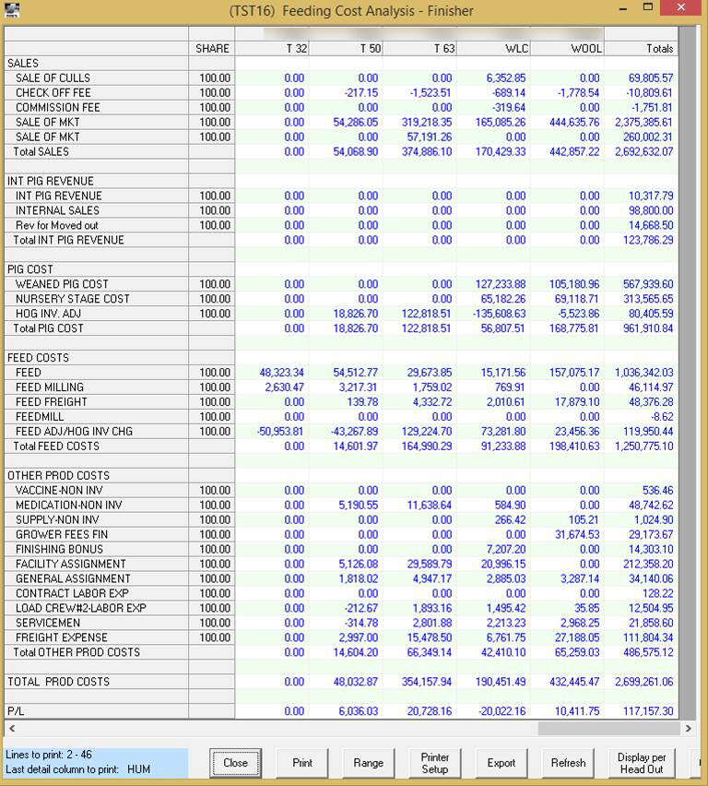
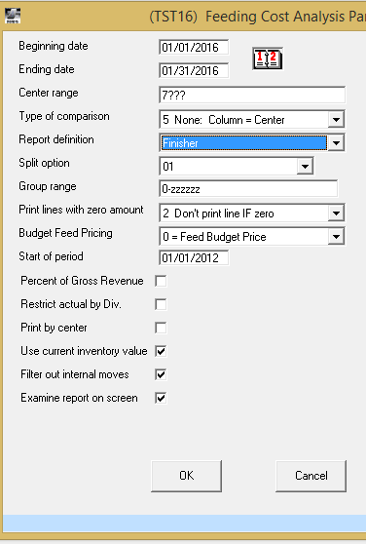

Slide 13
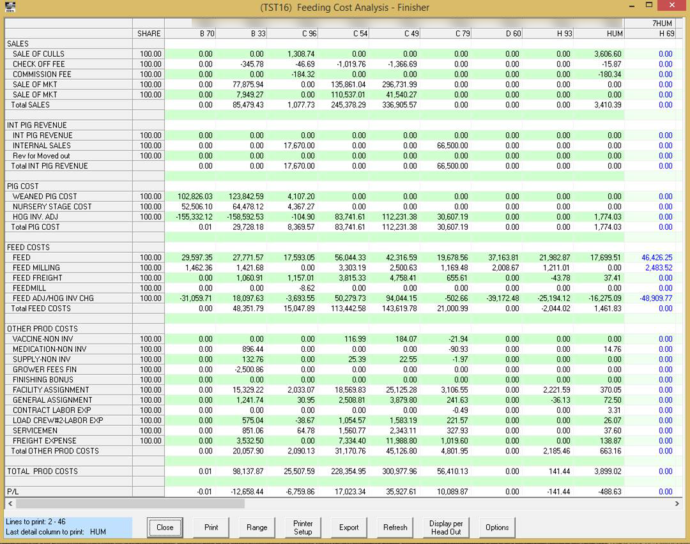

Slide 14
